Slide 1

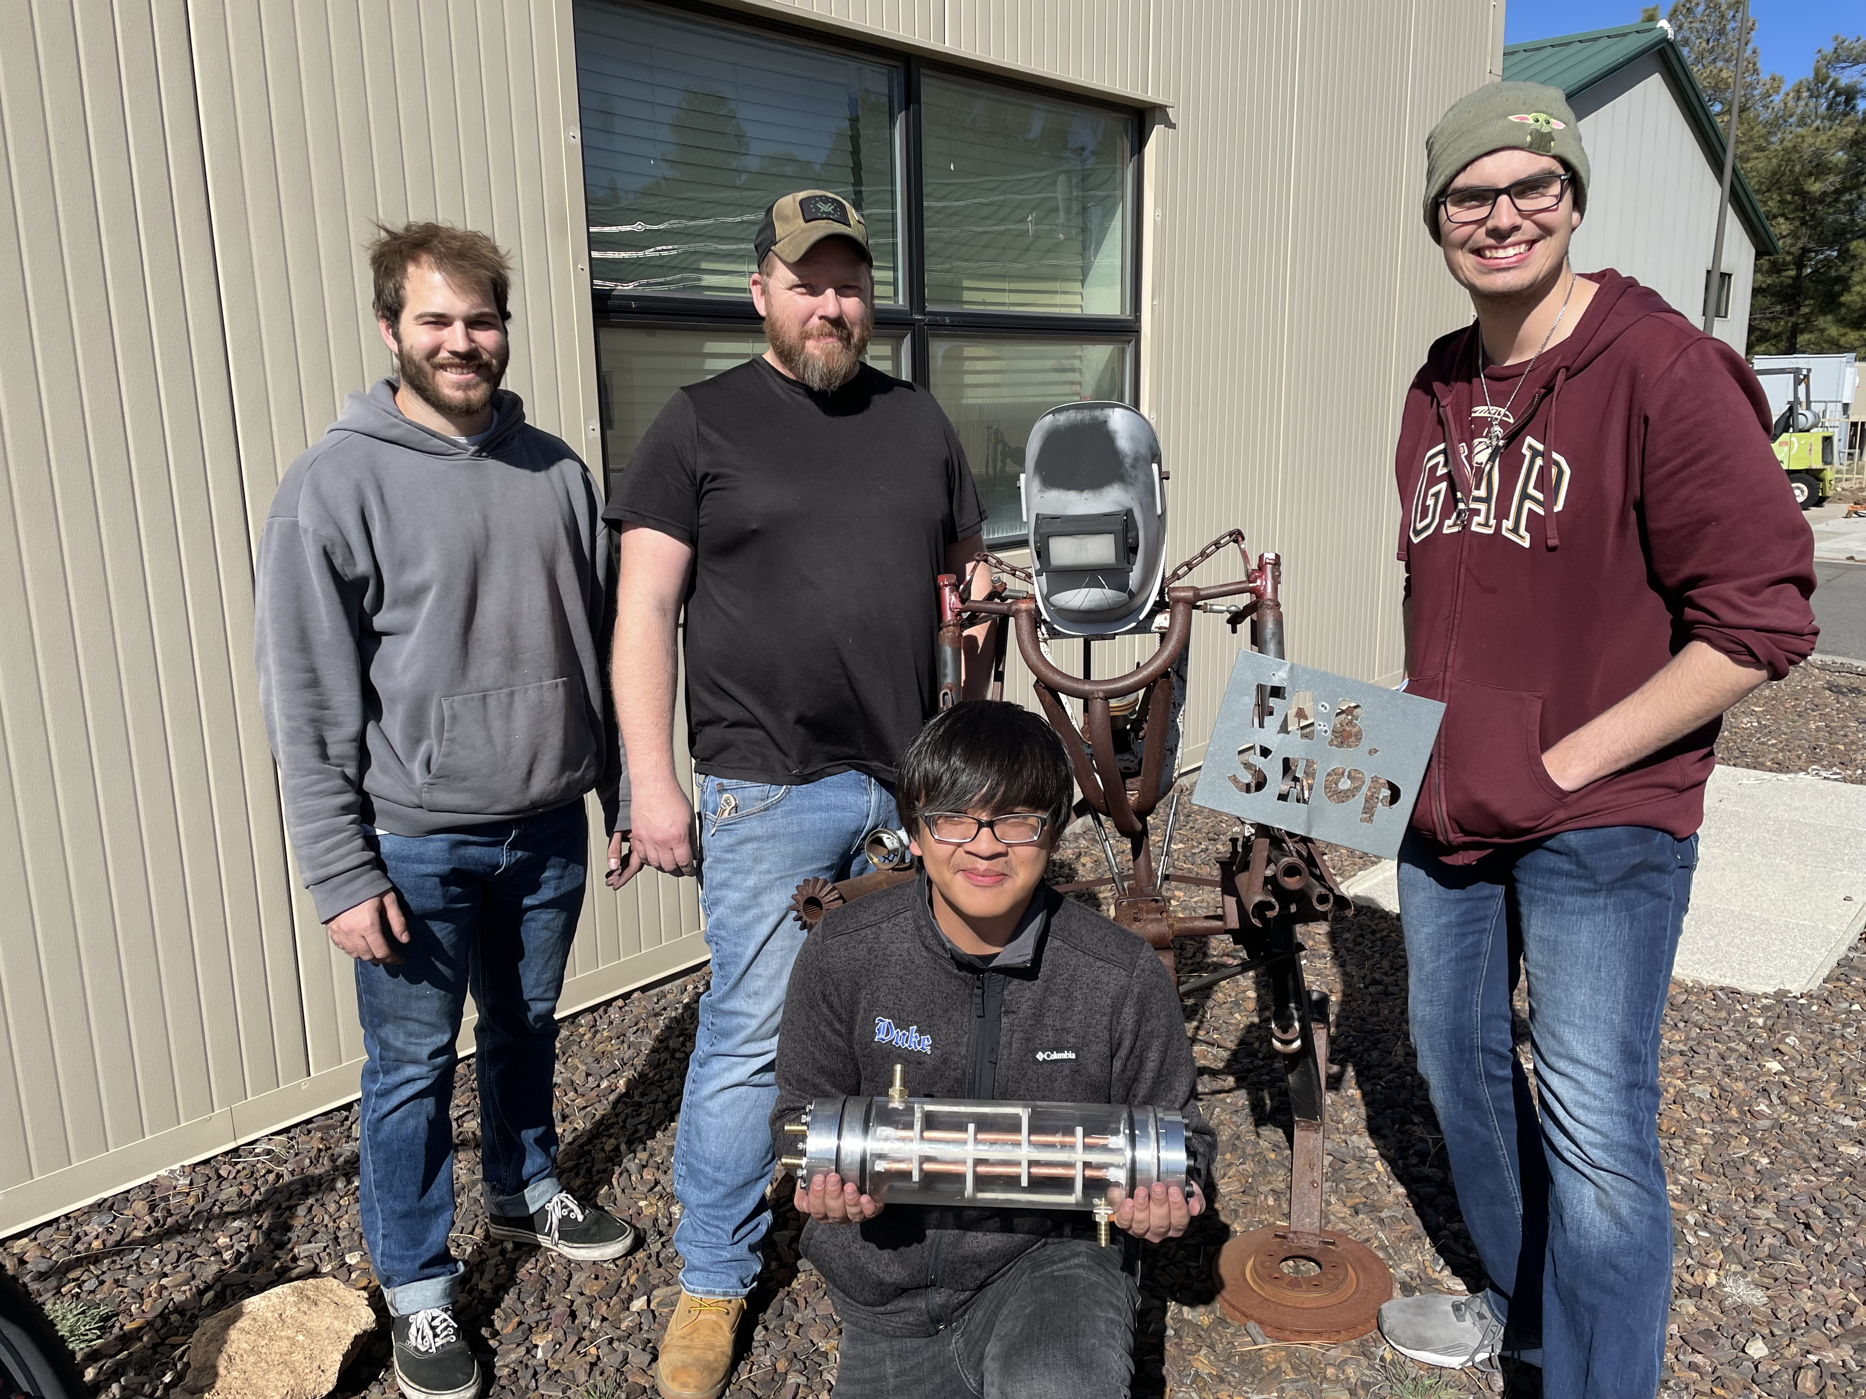
Boeing Heat Exchanger
4-26-24
Uriah Whitaker: Team Lead
Dennis Decker: Manufacturing Engineer
Christopher Mason: Test Engineer
Lorenz Vios: CAD Engineer

Slide 2
Background
Project Description​
Our project's primary objective is the design and creation of a liquid-to-liquid heat exchanger, with a strong emphasis on optimizing heat exchanger effectiveness.
Sponsor ​
The project is sponsored by Boeing, a leading aerospace company. The significance of this project lies in its potential to revolutionize heat exchange technology within aviation, aligning with Boeing's commitment to innovation and efficiency in aircraft systems. ​
Importance ​
Boeing is exploring a more environmentally friendly yet combustible refrigerant and plans to incorporate a heat exchanger behind a firewall to ensure pilot safety.
Budget/Funding
Given $5,000 from Boeing
Raised $1,000 from VA

Slide 3
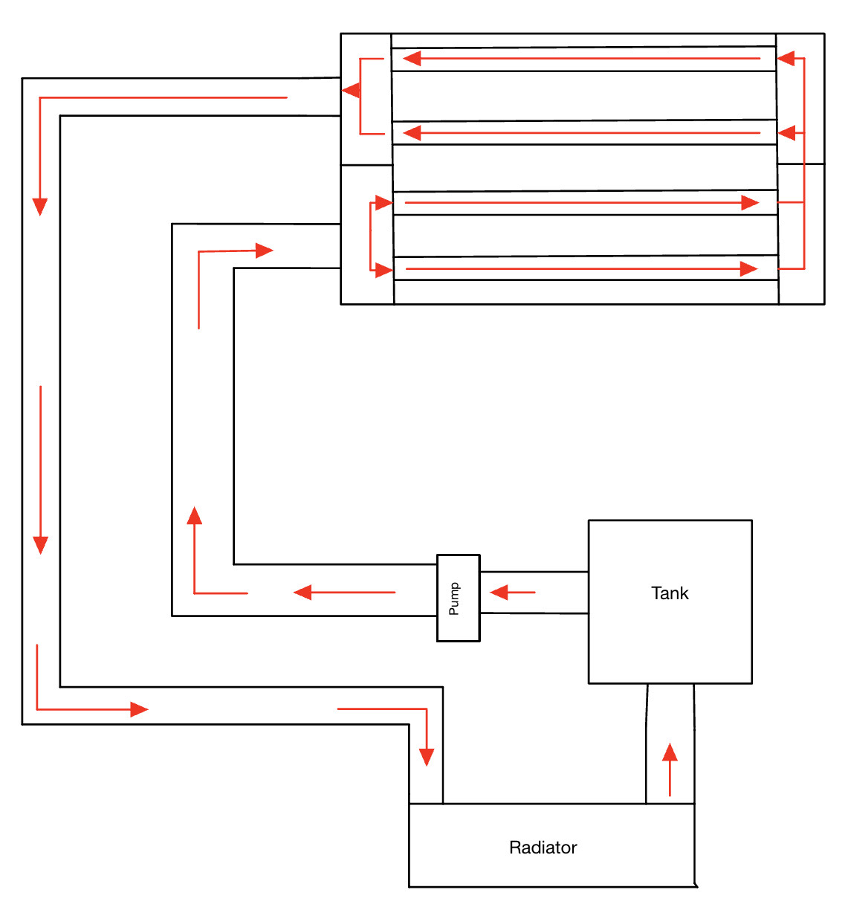
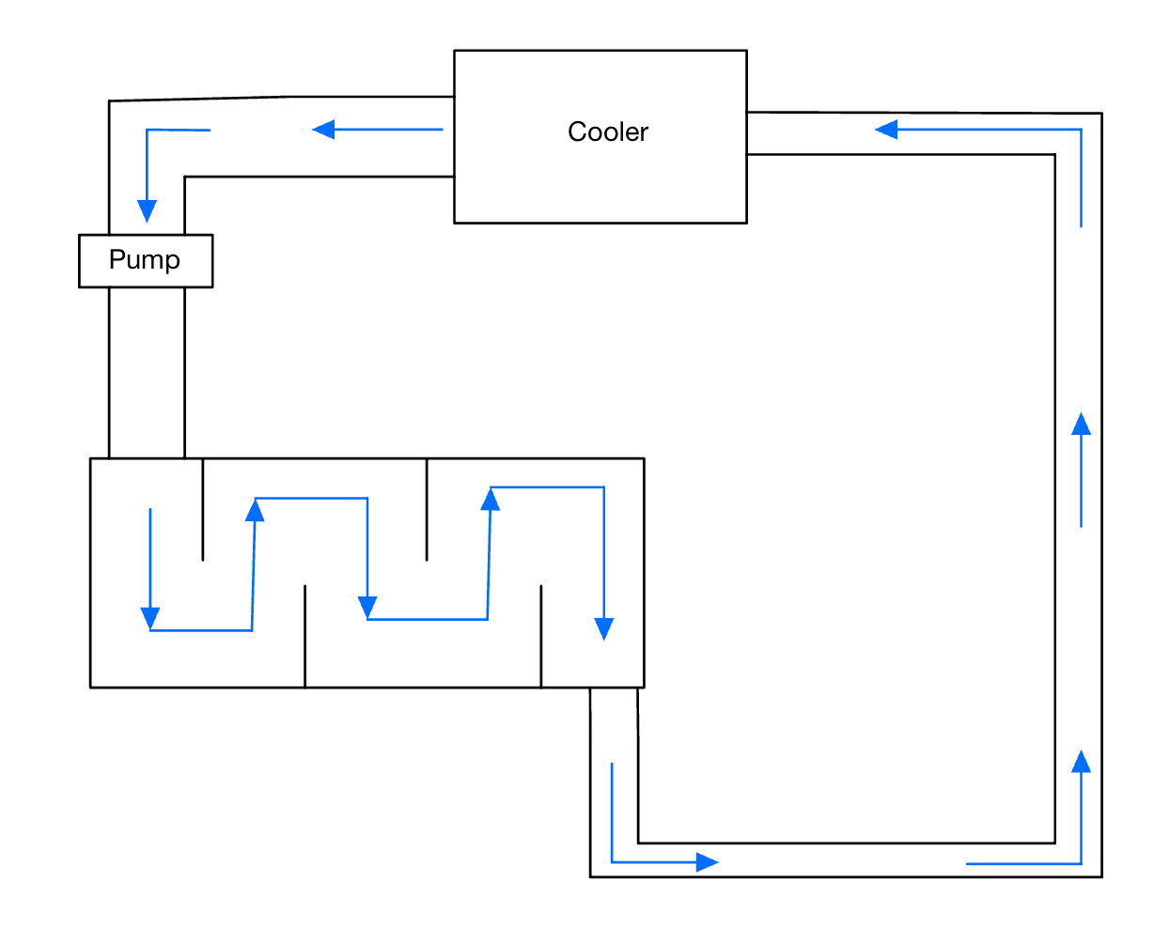
Background
Deliverables
Design a Liquid-to-Liquid Heat Exchanger.
Integrate into Demonstrator using off-the-shelf Components.
Presentations and Final Report.
Modeling, Data, and Test Results.
Success Metrics
Blows Cold Air to Judge's Hand (Temperature Testing).
Watertight Demonstrator (By Inspection).
Low Pressure Drop (Pressure Testing).
Figure 1. Coolant Loop
Figure 2. Ice Water Loop

Slide 4
Customer Requirements
Customer Requirement 1: The liquid coolant going into the radiator must be cold enough from the heat exchanger that when it conducts heat transfer to the air it will drop its temperature to a felt degree. ​
Customer Requirement 2: This system models the Apache Helicopter vapor compression system which will use HFO-1234yf which is a combustible refrigerant so a firewall will need to be put in place to isolate the cockpit from the refrigerant. ​
Customer Requirement 3: The liquid-to-liquid heat exchanger must meet this maximum sizing requirement. No weight constraint is specified. ​
Customer Requirement 4: Since the client requires the design of a demonstrator, they have requested clear housing to make the internal design of the heat exchanger visible. ​
Customer Requirement 5: The client would like to see the demonstration of the heat exchanger in person, so the system must be easy to transport and can be set up and operational within 1 hour. ​
Customer Requirement 6: The heat exchanger must continue to expel cold coolant to the radiator for a duration of 30 minutes.

Slide 5
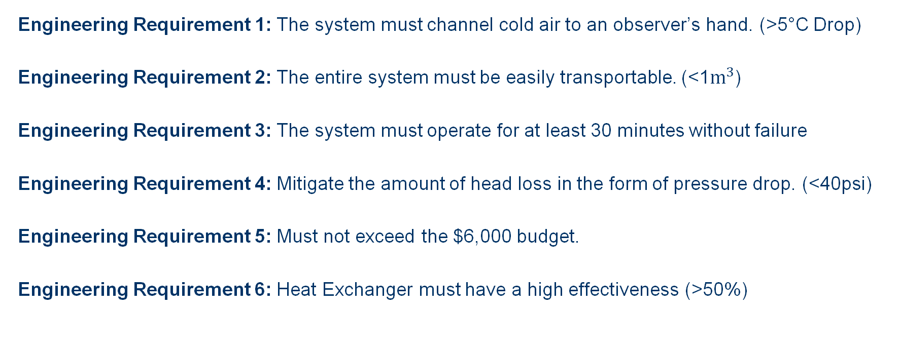
Engineering Requirements
Engineering Requirement 1: The system must channel cold air to an observer’s hand.​ (>5°C Drop)
Engineering Requirement 2: The entire system must be easily transportable.​ (<1$m^{3}$)
Engineering Requirement 3: The system must operate for at least 30 minutes without failure
Engineering Requirement 4: Mitigate the amount of head loss in the form of pressure drop.​ (<40psi)
Engineering Requirement 5: Must not exceed the $6,000 budget.​
Engineering Requirement 6: Heat Exchanger must have a high effectiveness (>50%)

Slide 6
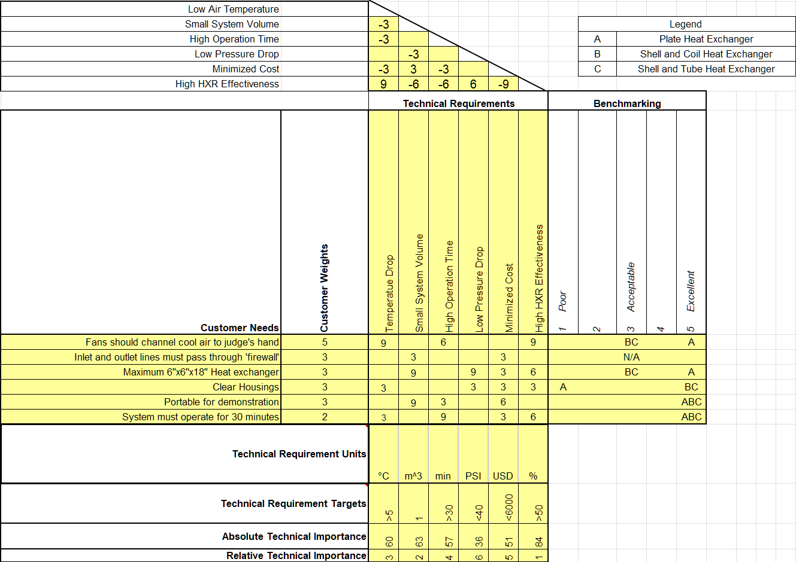
QFD
Figure 3. QFD

Slide 7
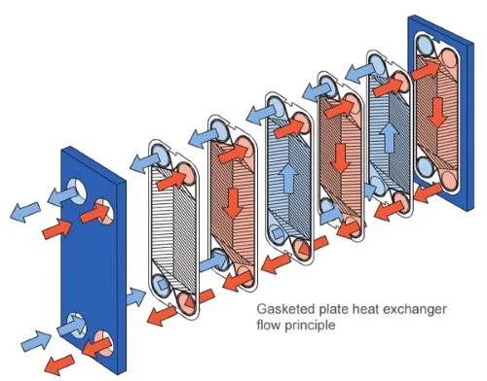
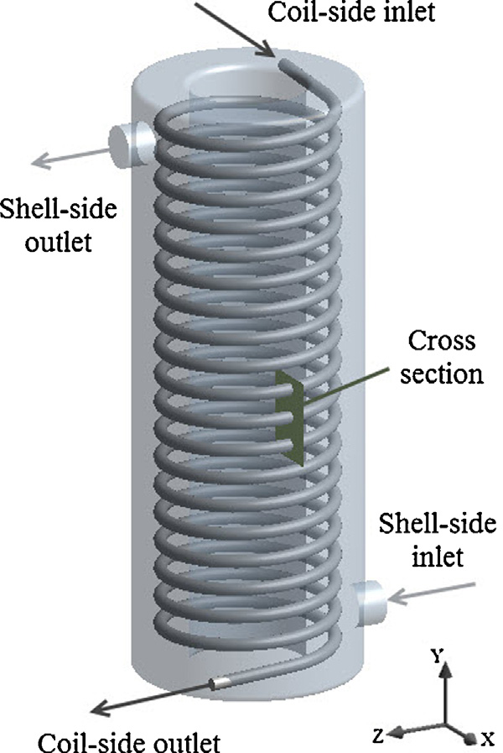
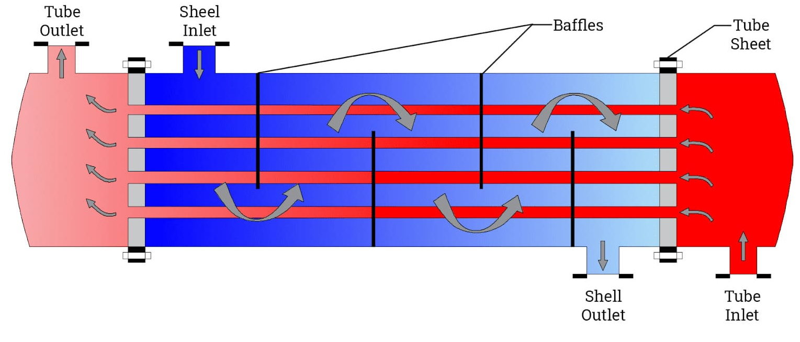
Benchmarking
Plate Heat Exchanger
Gives the best heat transfer per unit volume
Can’t easily manufacture
Difficult to implement clear housing
Shell and Coil Heat Exchanger
Difficult to manufacture
Low heat transfer per unit volume
Shell and Tube Heat Exchanger
Simple and well documented properties
Low heat transfer per unit volume
Easily manufacturable
Figure 4. Plate Heat Exchanger
Figure 5. Shell and Tube
Figure 6. Shell and Coil

Slide 8
Literature Review
Table 1. Project design sources
Heat Exchangers : Characteristics, Types and Emerging Applications [1] | Thermal and Acoustic Insulation [11]
Design and Operation of Heat Exchangers and their Networks-Chapter 3:Steady State characteristics of Heat exchangers [2] | Simon Ostrach’s Natural Convection in Enclosures [12]
Three-dimensional fin-tube expansion process to achieve high heat transfer efficiency in heat exchangers [3] | P.B.L Chaurasia’s Comparative study of insulating materials in solar water storage systems [13]
Heat Exchanger Design Handbook [4] | Thermo-economic analysis of old storage systems in full and partial modes with two different scenarios: A case study [14]
Fundamentals of Heat and Mass Transfer, Chapter 11 [5] | Fundamentals Of Heat and Mass Transfer, Chapter 6 [15]
Theory and Design for Mechanical Measurements, Fifth Edition [6] | Fox and Mcdonald’s Introduction to Fluid Mechanics, Chapter 4 [16]
Engineering Toolbox [7] | Thermal Energy Systems Design and Analysis 2nd Edition [17]
GrabCad SOLIDWORKS: How to perform a transient Thermal Analysis in SOLIDWORKS [8] | Final Temperature of mixtures (Richmann’s Law) [18]
GD&T and Stack up (Basic to expert level) [9] | Ice - Thermal Properties [19]
O-Ring Groove Design [10] | BUTELINE plumbing system - Polyethylene [20]

Slide 9
Literature Review (cont.)
Table 2. Project design sources (cont.)
Heat Transfer and Flow Characteristics of a Conical Coil Heat Exchanger [21] | Modelling of thermocouple geometry variations for improved heat transfer monitoring in smart electronic manufacturing environment [31]
Heat transfer enhancement for shell and coil heat exchanger [22] | Measurement of local wall temperature and heat flux using the two thermocouple method for a heat transfer tube [32]
Computational Fluid Dynamics Analysis for Shell and Tube Heat Exchangers [23] | Combination of Local Heat Transfer and Flow Visualization of R245fa Flow Boiling in plate Heat Exchanger[33]
Fox and Mcdonald’s Fundamentals of Fluid Mechanics, Chapter 8 [24] | Operator’s Manual for Army AH-64A Helicopter. 1989. [34]
DOE Fundamentals Handbook: Heat Transfer, Thermodynamics, and Fluid Flow [25] | Fundamentals of Engineering Thermodynamics, 8th ed Chapter 2 [35]
Fundamentals of Heat Exchanger Design [26] | Fundamentals of Engineering Thermodynamics, 8th ed Chapter 8 [36]
Plant Design and Economics for Chemical Engineers [27] | Arduino development cookbook [37]
Shell and Tube Heat Exchanger Pressure Drop [28] | WebsitesTinkercad [38]
Solution Setup in Ansys Fluent [29] | “PDE 101: Separation of Variables! ...or how I learned to stop worrying and solve Laplace’s equation [39]
Heat Transfer Modeling in Ansys Fluent [30] | Arduino Thermocouple and LCD Tutorial [40]

Slide 10
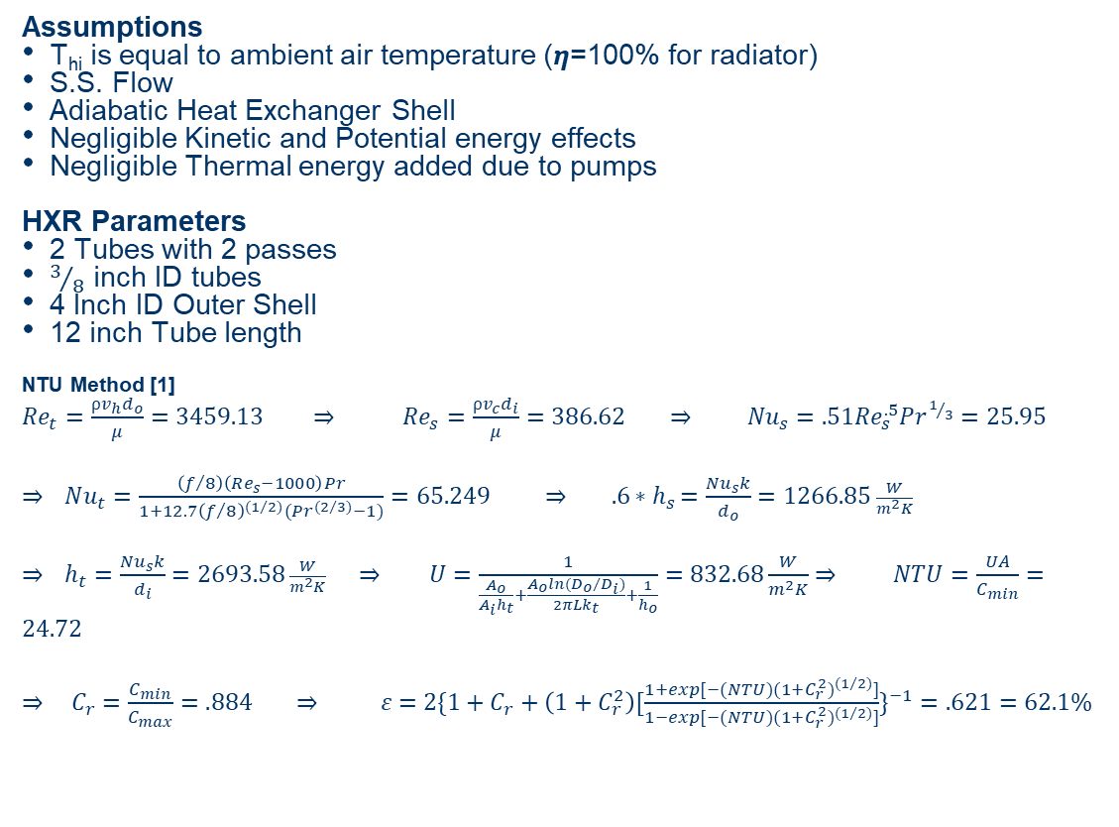
Mathematical Modeling – Heat Transfer
Assumptions
T_{hi} is equal to ambient air temperature (𝞰=100% for radiator)
S.S. Flow
Adiabatic Heat Exchanger Shell
Negligible Kinetic and Potential energy effects
Negligible Thermal energy added due to pumps
HXR Parameters
2 Tubes with 2 passes
$3/8$ inch ID tubes
4 Inch ID Outer Shell
12 inch Tube length
NTU Method [1]
${Re}_{t}=\frac{⍴v_{h}d_{o}}{μ}=3459.13 ⇒$ ${Re}_{s}=\frac{⍴v_{c}d_{i}}{μ}=386.62 ⇒$ ${Nu}_{s}=.51{Re}_{s}^{.5}Pr^{1/3}=25.95$
$⇒$ $Nu_{t}=\frac{\left(f/8\right)\left(Re_{s}−1000\right)Pr}{1+12.7{\left(f/8\right)}^{{(1}/{2)}}(Pr^{{(2}/{3)}}−1)}=65.249 ⇒ {.6∗h}_{s}=\frac{{Nu}_{s}k}{d_{o}}=1266.85 \frac{W}{m^{2}K}$
$⇒$ $h_{t}=\frac{{Nu}_{s}k}{d_{i}}=2693.58 \frac{W}{m^{2}K} ⇒$ $U=\frac{1}{\frac{A_{o}}{A_{i}h_{t}}+\frac{A_{o}ln⁡({D_{o}}/{D_{i})}}{2πLk_{t}}+\frac{1}{h_{o}}}=832.68\frac{W}{m^{2}K}⇒$ $NTU=\frac{UA}{C_{min}}=24.72$
$⇒$ $C_{r}=\frac{C_{min}}{C_{max}}=.884 ⇒ ε=2\{1+C_{r}+\left(1+C_{r}^{2}\right)[\frac{1+exp[−(NTU)(1+C_{r}^{2})^{{(1}/{2)}}]}{1−exp[−(NTU)(1+C_{r}^{2})^{{(1}/{2)}}]}\}^{−1}=.621=62.1\%$
Results
For 𝐶_𝑟 =.884, 𝜀_𝑚𝑎𝑥 of 62% is reached at approximately NTU=5.5 according to [5] so this design has enough heat transfer that internal inefficiencies should not affect our 𝜀_actual.

Slide 11
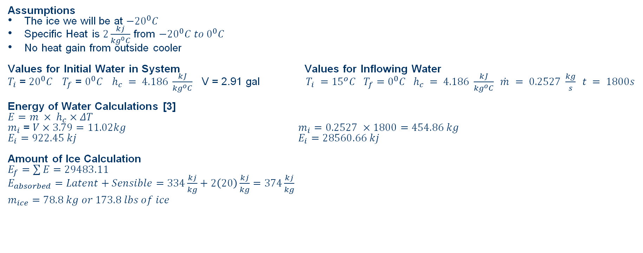
Mathematical Modeling – Ice Water Amount
Assumptions
The ice we will be at ${−20}^{0}C$
Specific Heat is $2\frac{kj}{{kg}^{0}C}$ from ${−20}^{0}C to 0^{0}C$
No heat gain from outside cooler
Values for Initial Water in System Values for Inflowing Water​
$T_{i}$ = ${20}^{0}C$ $T_{f}$ = $0^{0}C$ $h_{c} = 4.186 \frac{kJ}{{kg}^{o}C}$ V = 2.91 gal $T_{i} ={15}^{o}C T_{f}=0^{0}C{ h}_{c} = 4.186 \frac{kJ}{{kg}^{o}C} \dot{m} = 0.2527 \frac{kg}{s} t = 1800s​$
Energy of Water Calculations [3]
$E=m × h_{c}×ΔT$
$m_{i}$ = $V×3.79=11.02kg$ $m_{i}=0.2527 ×1800=454.86 kg$
$E_{i}=922.45 kj$ $E_{i}=28560.66 kj$
Amount of Ice Calculation
$E_{f}=\sum{E}=29483.11$
$E_{absorbed}=Latent+Sensible=334\frac{kj}{kg}+2\left(20\right)\frac{kj}{kg}=374\frac{kj}{kg}$
$$m_{ice}=78.8 kg or 173.8 lbs of ice$$

Slide 12
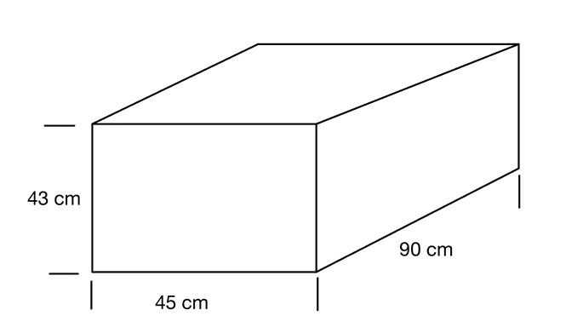
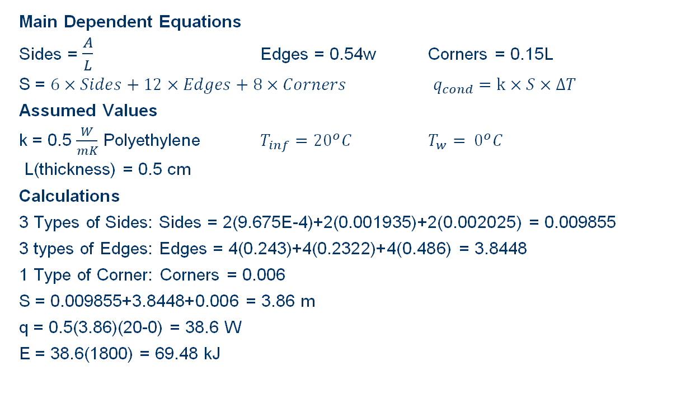
Mathematical Modeling – Cooler Heat Transfer
Main Dependent Equations
Sides = $\frac{A}{L}$ Edges = 0.54w Corners = 0.15L
S = $6×Sides+12×Edges+8×Corners$ $q_{cond}=k×S×ΔT$
Assumed Values
k = 0.5 $\frac{W}{mK}$ Polyethylene $T_{inf}={20}^{o}C$ $T_{w}= 0^{o}C$
L(thickness) = 0.5 cm
Calculations
3 Types of Sides: Sides = 2(9.675E-4)+2(0.001935)+2(0.002025) = 0.009855
3 types of Edges: Edges = 4(0.243)+4(0.2322)+4(0.486) = 3.8448
1 Type of Corner: Corners = 0.006
S = 0.009855+3.8448+0.006 = 3.86 m
q = 0.5(3.86)(20-0) = 38.6 W
E = 38.6(1800) = 69.48 kJ
Figure 7. Cooler FBD

Slide 13
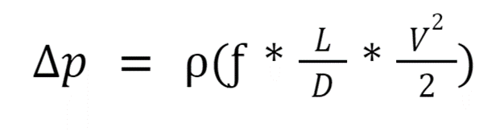
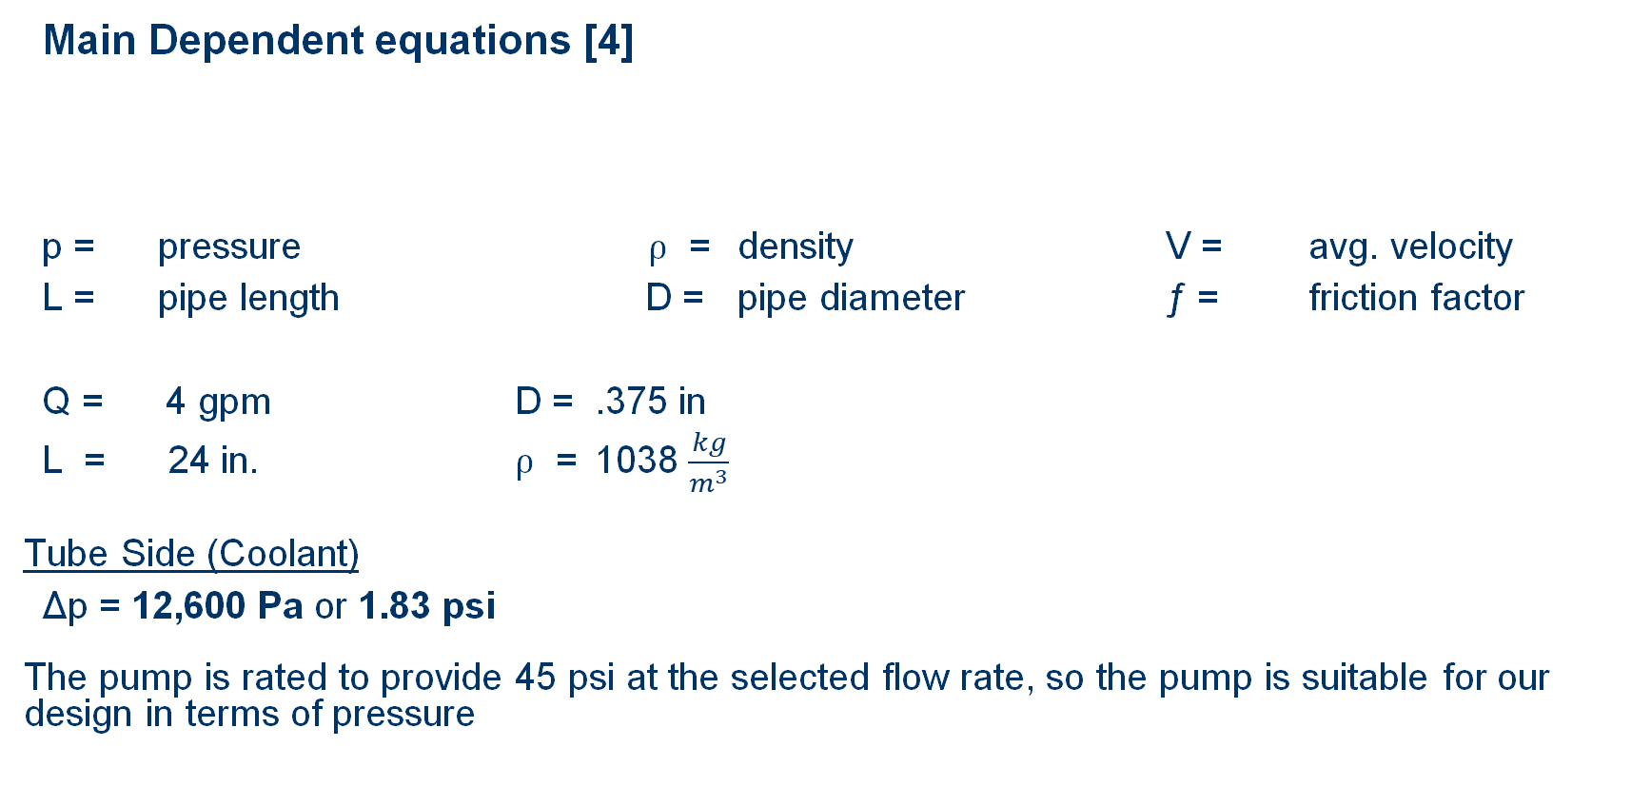
Mathematical Modeling – Pressure Drop
Main Dependent equations [4]
p = pressure ⍴ = density V = avg. velocity
L = pipe length D = pipe diameter ƒ = friction factor
Q = 4 gpm D = .375 in
L = 24 in. ⍴ = 1038 $\frac{kg}{m^{3}}$
Tube Side (Coolant)
Δp = 12,600 Pa or 1.83 psi
The pump is rated to provide 45 psi at the selected flow rate, so the pump is suitable for our design in terms of pressure

Slide 14
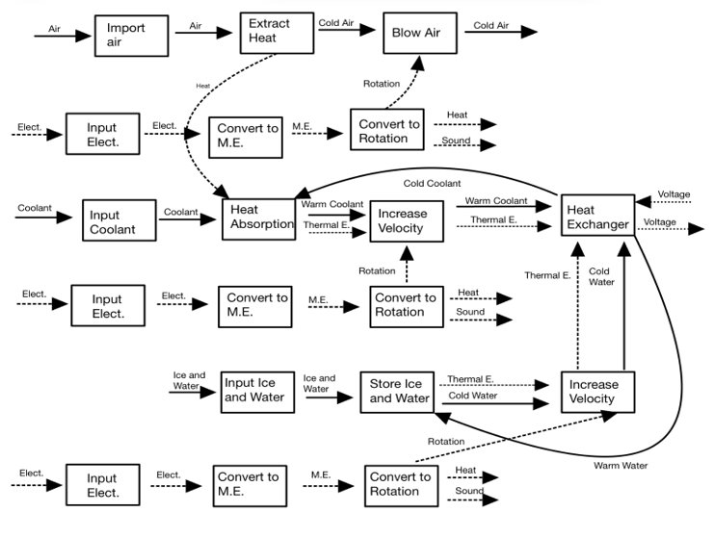
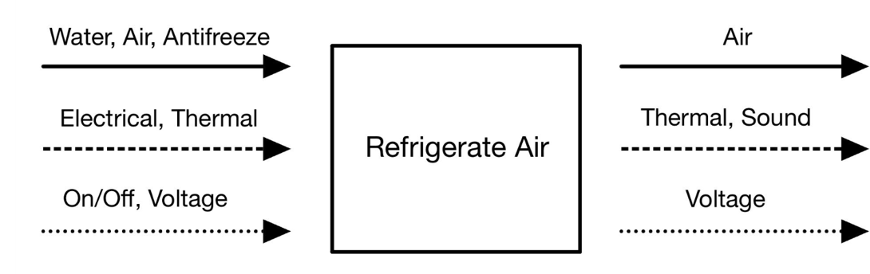
Functional Decomposition
Figure 8. Black Box Model
Figure 9. Functional Model

Slide 15
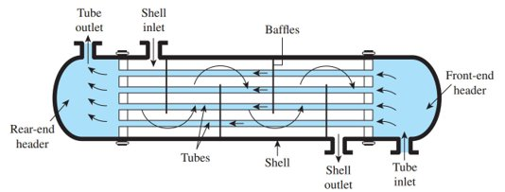
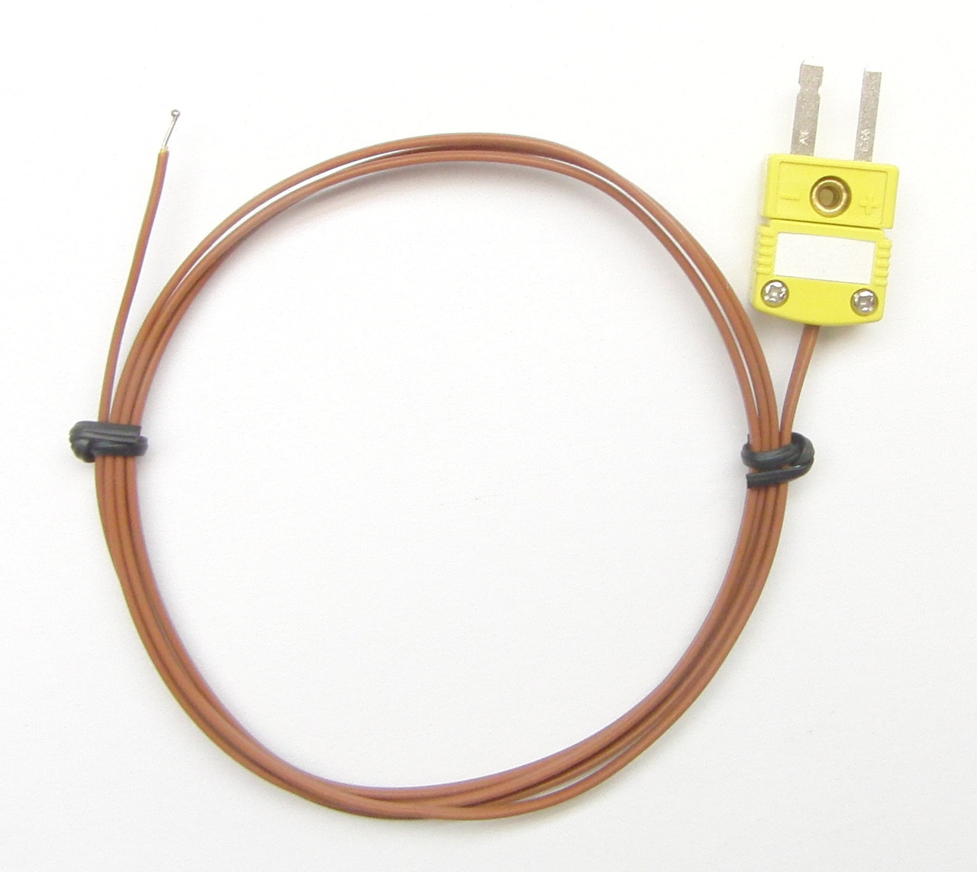
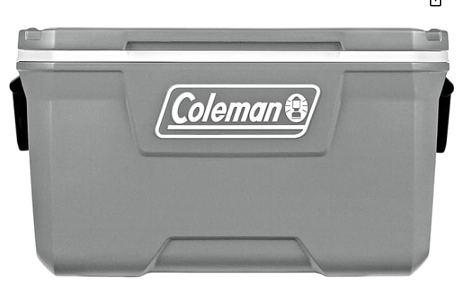
Concept Generation
Selecting Heat Exchanger Type
  Manufacturing Expenses​
  Pressure Drop​
  Surface Area​
Heat Exchanger Heat Transfer
  Thermal Conductivity​
  Environmentally Safe Coolant​
Ice Water reservoir selection
  Heat Transfer through cooler wall​
  Amount of Ice​
  Amount of water to complete one loop​
Thermocouple selection​
  Accuracy​
  Cost​
Figure 10. Shell and Tube Heat Exchanger
Figure 11. Cooler
Figure 12. K-type Thermocouple with Micro Adapter

Slide 16
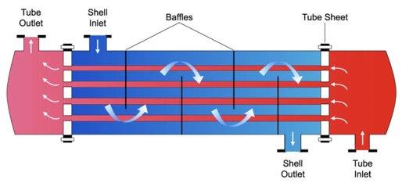
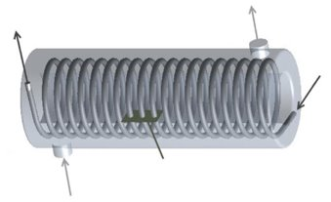
Preliminary Concepts
Design A:​
Tube Material: Copper​
Coolant: 50/50 Propylene Glycol​
Heat Exchanger Type: Straight Tube and Shell; 1 pass​
Cooler Insulation: Polyurethane​
Design B:​
Tube Material: Aluminum​
Coolant: 50/50 Ethylene Glycol​
Heat Exchanger Type: Coiled Tube and Shell​
Cooler Insulation: Polystyrene​
Figure 5. Shell and Tube Heat Exchanger
Figure 13. Shell and Helical Heat Exchanger

Slide 17
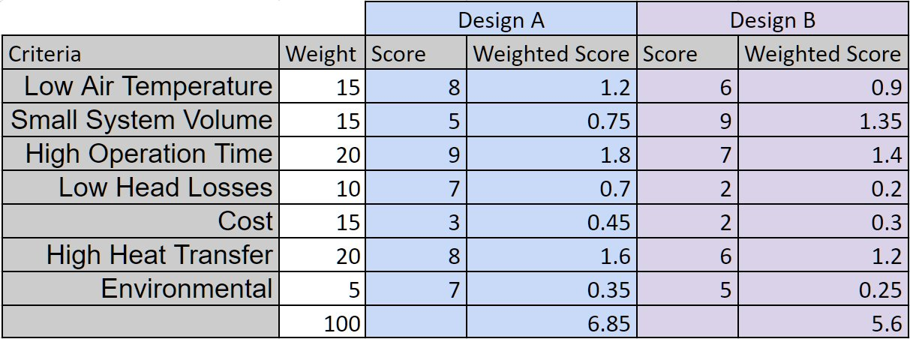
Decision Matrix
Table 3. Decision Matrix

Slide 18
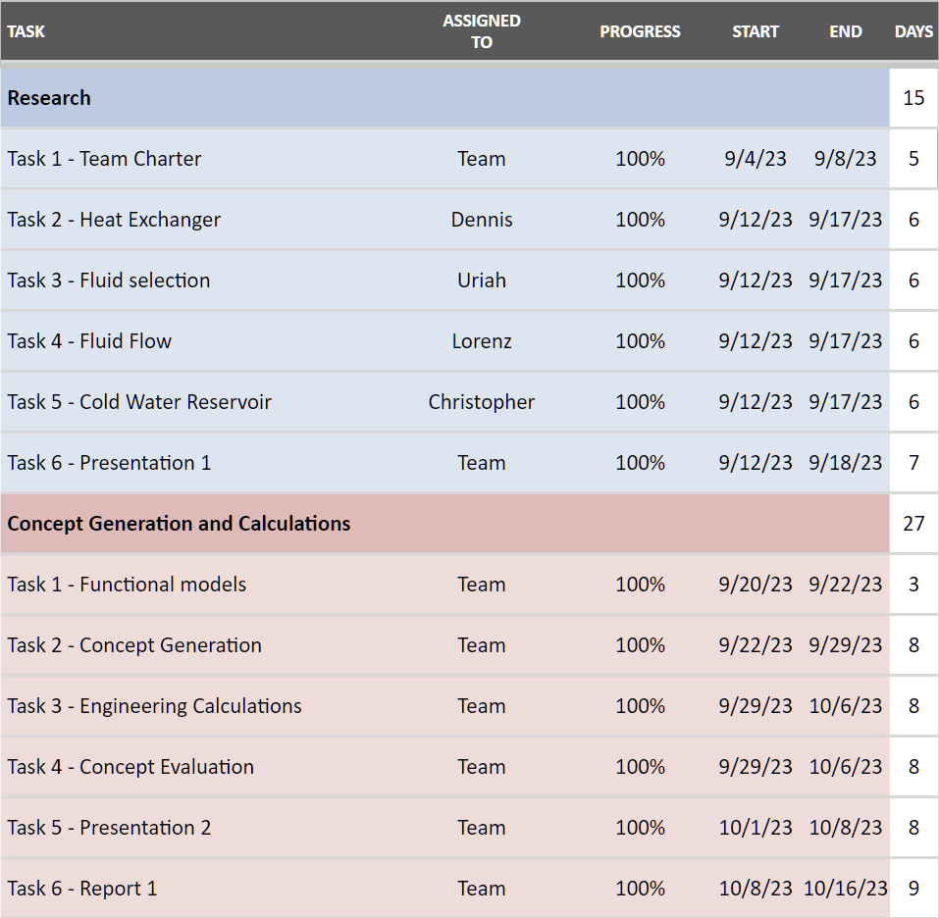
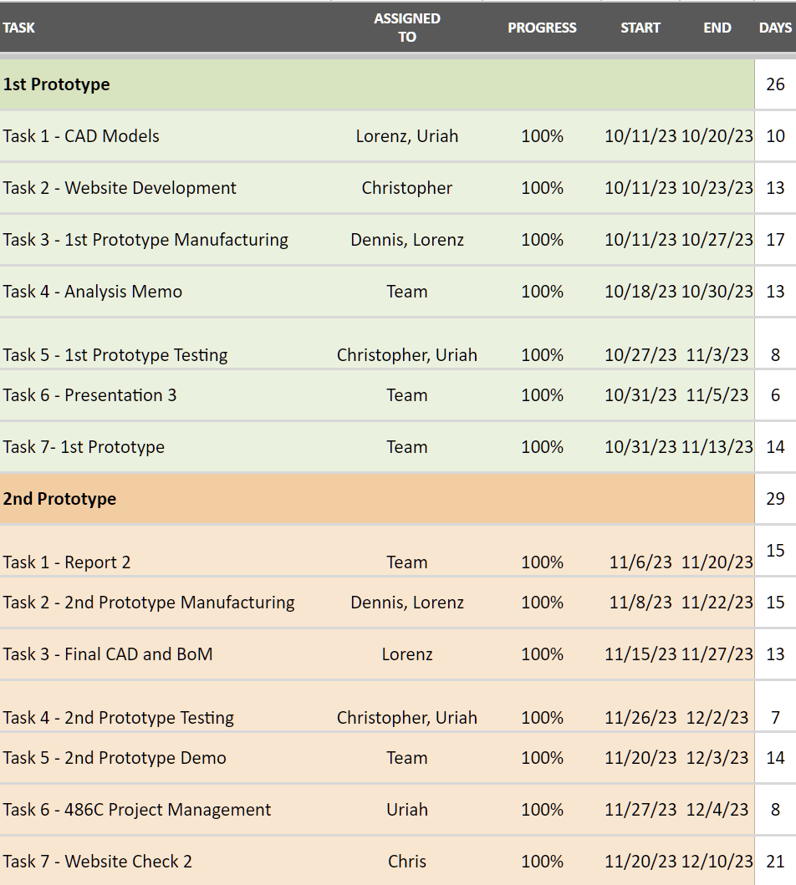
Schedule – First Semester
Figure 14. First Semester Gantt Chart
Figure 15. First Semester Gantt Chart (cont.)

Slide 19
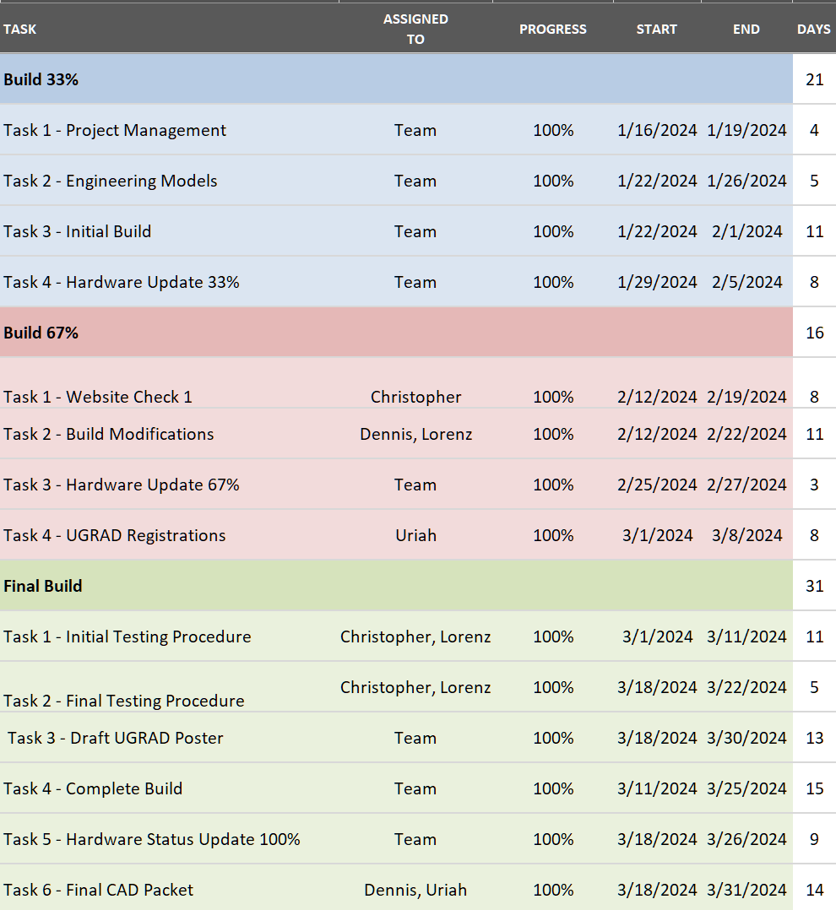
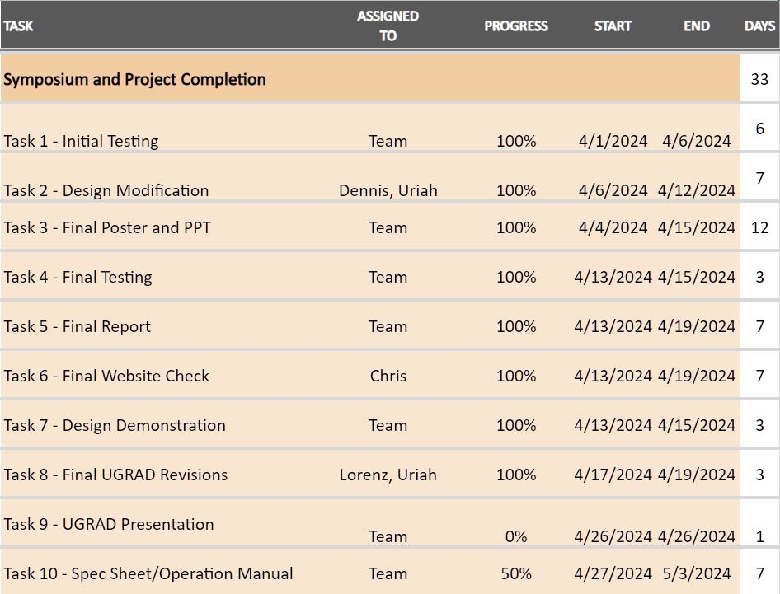
Schedule – Second Semester
Figure 17. Second Semester Gantt Chart (cont.)
Figure 16. Second Semester Gantt Chart

Slide 20
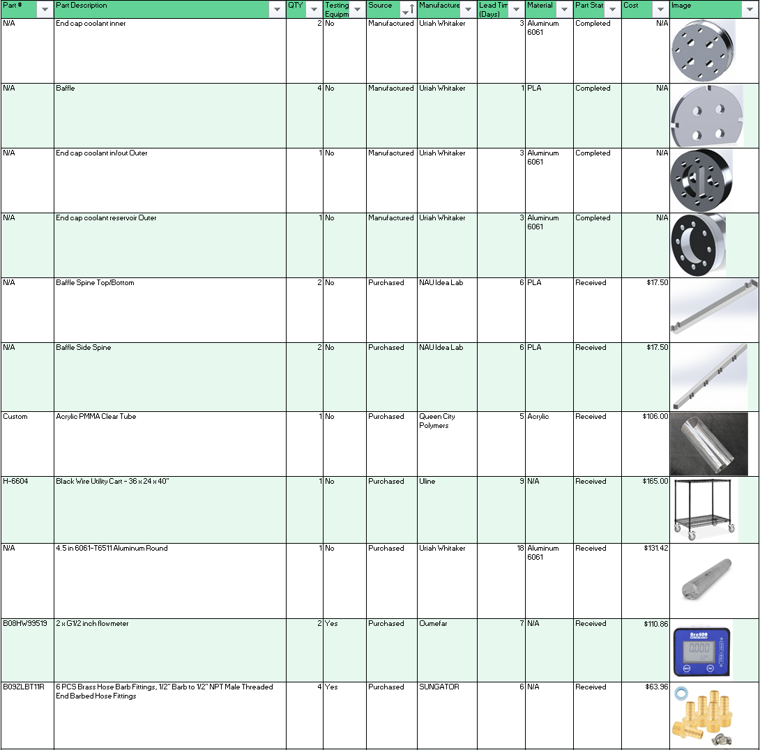
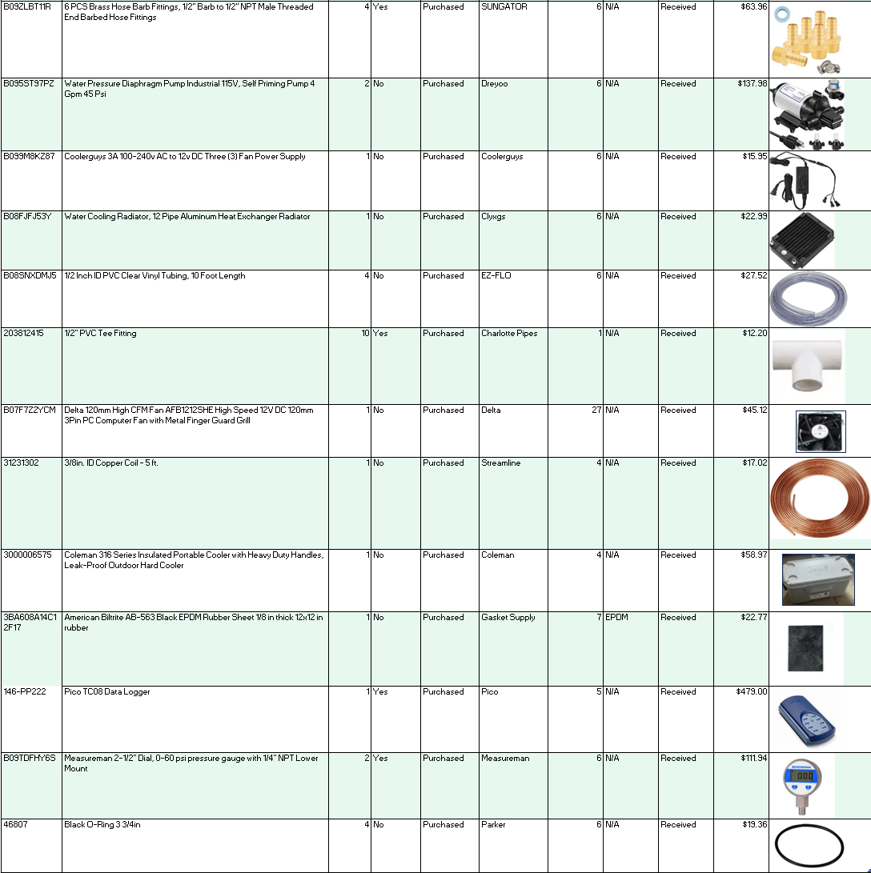
Bill of Materials
Table 4. Final Bill of Materials
Table 4. Final Bill of Materials (cont.)

Slide 21
Budget
Funding
Client Funding: $ 5,000.00
VA Grant: $ 1,000.00
__________________________________________________________________
Total Budget: $ 6,000.00
Expenses
Total Unit Cost (excl. Testing Equipment): $ 772.33
Total Testing Equipment Cost: $ 777.96
Additional Expenditures (Prototyping, spare parts, etc.): $ 665.81
__________________________________________________________________
Project Cost to Date: $ 2,216.10

Slide 22
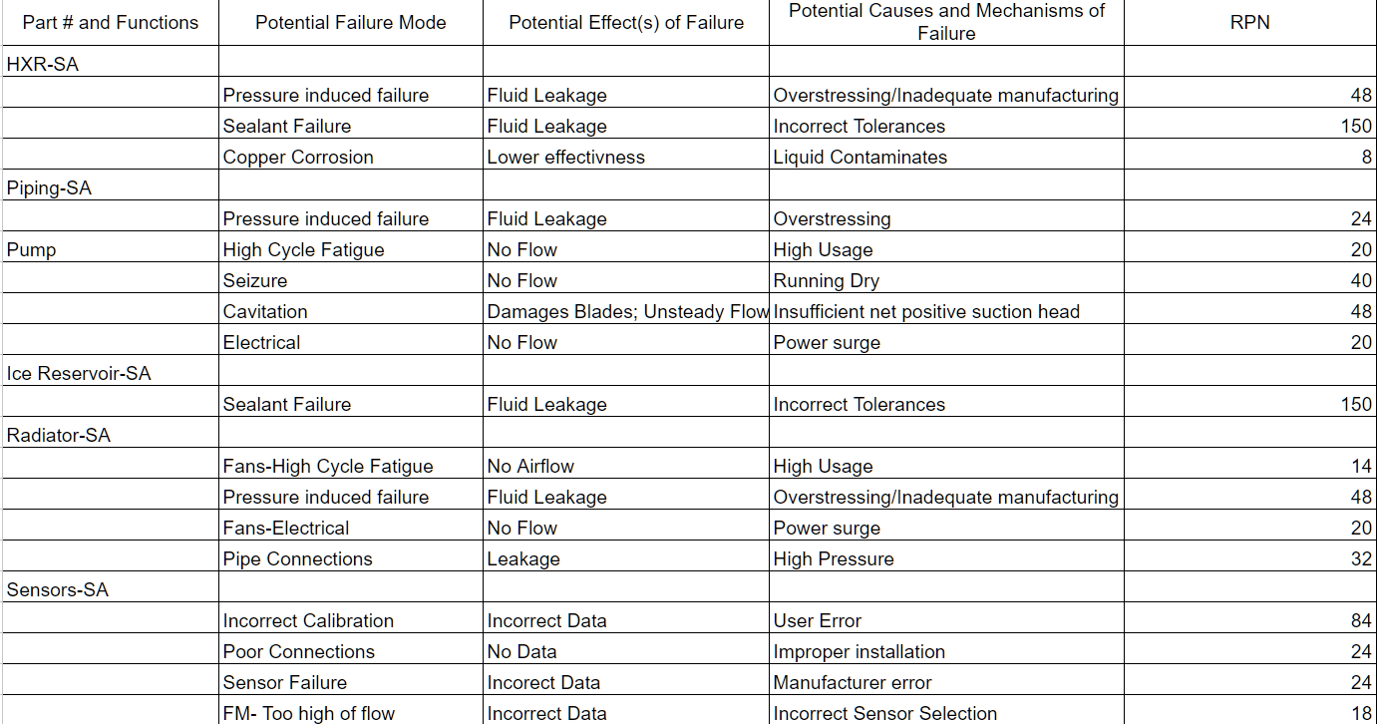
Failure Mode Analysis
Table 5. FMEA

Slide 23
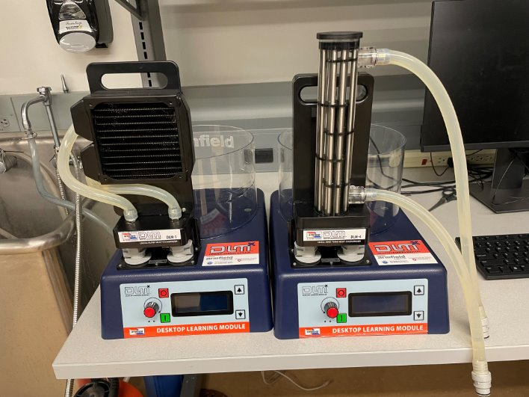
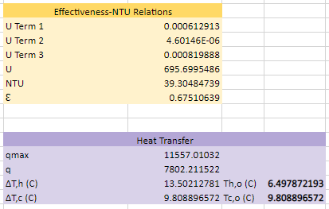
Prototype 1 – Modeling Verification
Main Objective
To verify the accuracy and method used to predict the final heat exchanger outputs
Result
It proved our mathematical models were correct and we could proceed with the design stage
Iteration plan
Experiment with different heat exchanger geometries with a focus on pressure drops to verify system has adequate heat transfer and sufficiently low head loss
Figure 18. Test set up
Figure 19. Mathematical Model results

Slide 24
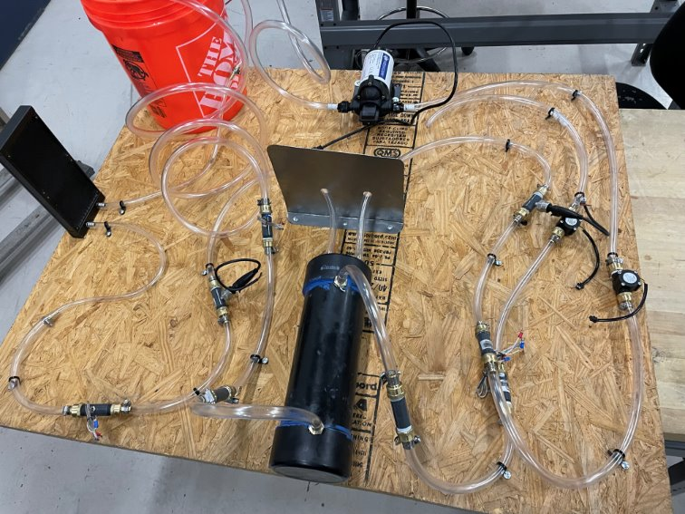
Prototype 2 – Production Trial
Main Objective
To build the final test set up with a goal of identifying potential problems for future manufacturing
Result
It identified several problem areas including thermocouple leakage, hose mounting, and method of heat exchanger sealing/sealant used
Iteration plan
To replace use of sealants with gaskets and O-rings, utilize different thermocouples to minimize leakage
Figure 20. Manufacturing test assembled

Slide 25
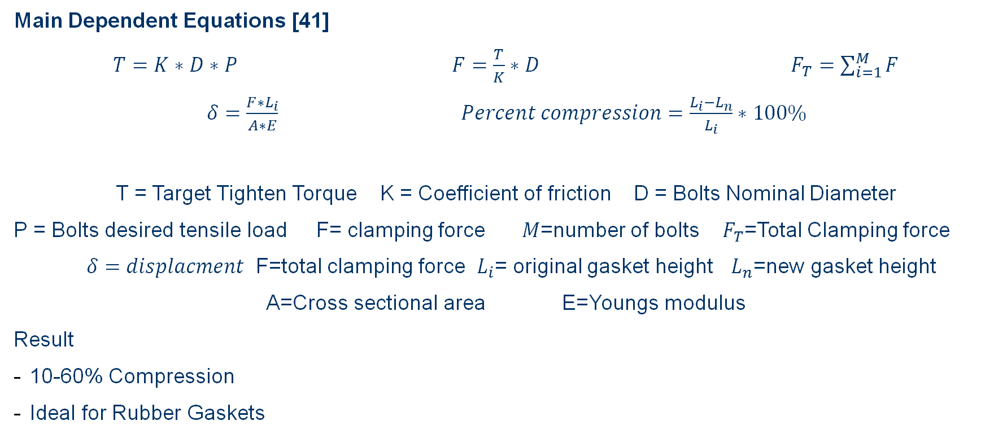
Additional Calculations - Gaskets
Main Dependent Equations [41]
$T=K∗D∗P$ $F=\frac{T}{K}∗D$ $F_{T}=\sum_{i=1}^{M}{F}$
$δ=\frac{F∗L_{i}}{A∗E}$ $Percent compression=\frac{L_{i}−L_{n}}{L_{i}}∗100\%$
T = Target Tighten Torque K = Coefficient of friction D = Bolts Nominal Diameter
P = Bolts desired tensile load F= clamping force $M$=number of bolts $F_{T}$=Total Clamping force
$δ=displacment$ F=total clamping force $L_{i}$= original gasket height $L_{n}$=new gasket height
A=Cross sectional area E=Youngs modulus
Result
10-60% Compression
Ideal for Rubber Gaskets

Slide 26
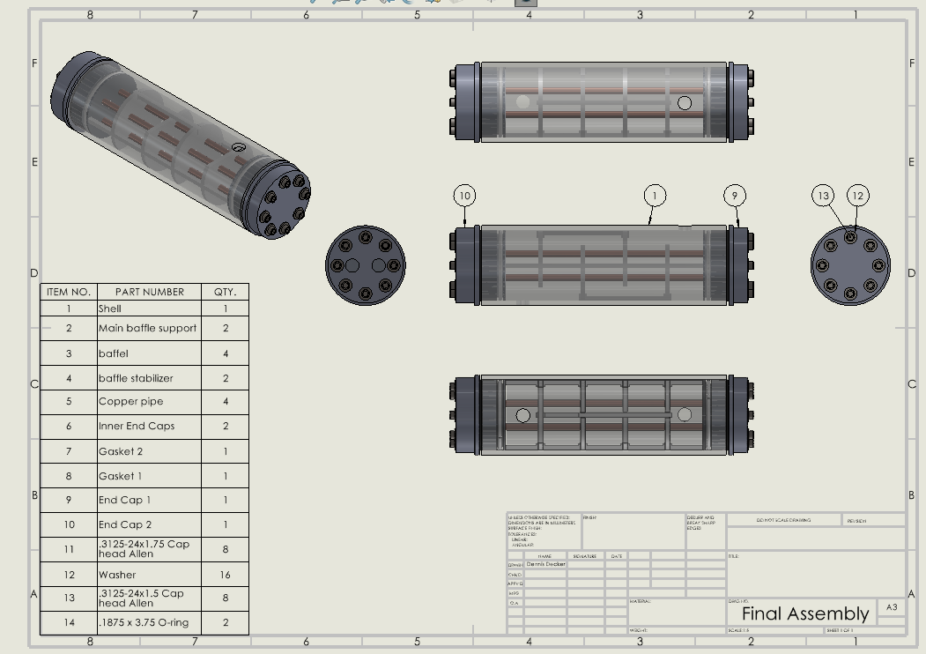
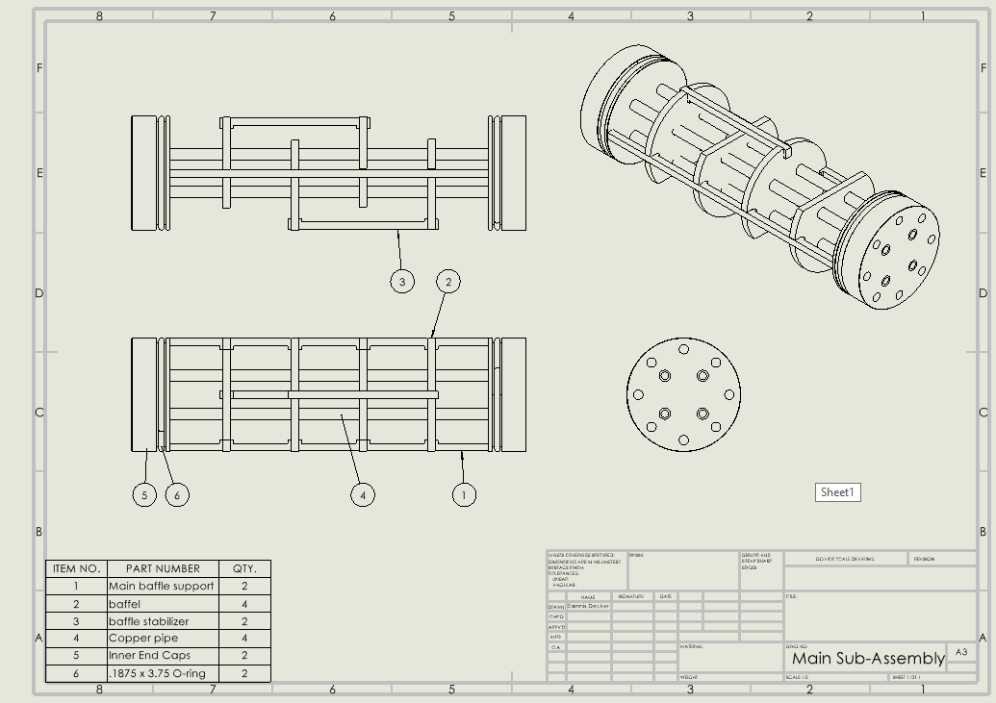
Final Hardware
Figure 21. Final Assembly
Figure 22. Main Sub-Assembly

Slide 27
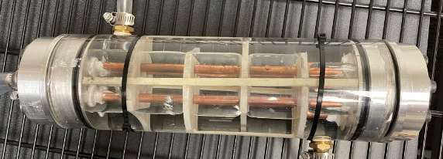
Final Hardware
Design Summary
2 Pass 2 Tube Shell and Tube Heat exchanger
3D printed Baffles/Baffle mounting
Clear acrylic outer shell – ¼ in. Thick
T-6061 Aluminum End caps
Aluminum manufactured in-house utilizing Lathe and 3-Axis vertical mill
Copper tubing utilized for heat transfer
Utilizes O-rings to seal ice water in shell
Rubber gaskets and 8 Cap head allens are used to seal the end caps and coolant fluid
Figure 23. Final Product

Slide 28
Top Level Testing Summary
Table 6. Testing summary
Experiment/Test | Relevant DRs | Testing Equipment Needed | Other resources
Exp 1 – Inlet/Outlet Temperature Test | CR1 – Temperature drop ER1 – Channel cold air ER3 – Run for 30 minutes ER6 – 60% effectiveness | Heat Exchanger / Full setup Thermocouples PICO Data Logger Computer | Thermo Fluids Lab
Exp 2 – Pressure Drop | ER4 - Low pressure drop | Heat exchanger / Full setup Pressure Gauges | Thermo Fluids Lab
Exp 3 – Sealing Tests | CR6 – 30 minute duration ER3 – Run for 30 minutes | Heat Exchanger/ Partial setup (Pump/ HX / gaskets/ o-rings) Means to make a video | Thermo Fluids Lab/ Machine shop

Slide 29
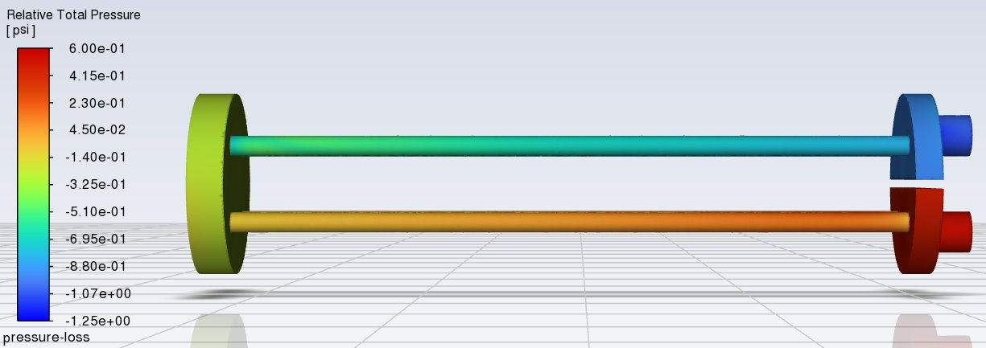
Pressure Drop Testing
Main question
  This experiment will determine the pressure drop across the heat exchanger to meet ER4
Equipment
  Two 0-60 PSI digital pressure gauges
Procedure
  Turn on digital pressure gauges and pumps.
  Wait until both pressure gauges have stabilized their readings.
  Calculate the difference between inlet and outlet pressures for each fluid.
Results
  Expected: ~1.8 PSI
  Measured: 2.2 PSI
Figure 24. Ansys Fluent Pressure Simulation

Slide 30
Inlet/Outlet Temperature Testing
Main question
  The team will be testing for final output temperatures to meet DR’s 1,3,6
Equipment
  Utilize 8 thermocouples to verify temperature distributions
  Utilize Pico TC-08 for data collection
Procedure
  Connect thermocouples to TC-08.
  Start PicoLog and enable all channels, setting sample interval to 100ms.
  Power on pumps and fans to start the system.
  Wait for temperatures to reach steady state operation.
  Calculate the effectiveness of the heat exchanger.
  Calculate the temperature of the outlet air.
Results
  Expected results: 62% effectiveness and 7.6 KW of heat transfer
  Measured results: 29% effectiveness and 3.6 KW of heat transfer
  Achieved coolant temperature drop of 5.4 °C

Slide 31
Seal Testing
Main questions
  This experiment will test the seals to meet CR6 and ER3
  Gaskets, O-rings, Epoxy are critical points
Procedure
  Turn on pumps to start fluid flows.
  Set timer for 30 minutes.
  Check for external leaks in fittings and connections in between plastic tubing sections.
  Check for external leaks in both heat exchanger end caps (gaskets and O-rings)
  Check for internal leaks in the heat exchanger.
  Repeat leak checks until timer ends.
Results
  System remains leak free for desired run time

Slide 32
Specification Sheets
Table 7. Project Results - Customer Requirements
Customer Requirement | CR met? (✓ or X) | Client Acceptable? (✓ or X)
CR1 – Air Temperature | ✓ | ✓
CR2 – Firewall Installed | ✓ | ✓
CR3 – HXR Volume Limit | ✓ | ✓
CR4 – Clear HXR | ✓ | ✓
CR5 – Portable System | ✓ | ✓
CR6 – 30min Operation | ✓ | ✓
Table 8. Project Results - Engineering Requirements
Engineering Requirement | Target | Measured/ Calculated Value | ER met? (✓ or X) | Client Acceptable? (✓ or X)
ER1 – Low Air Temp | 5 °C drop | 5.4 °C | ✓ | ✓
ER2 – Small System Volume | < 1 m³ | .16 m³ | ✓ | ✓
ER3 – High Operation Time | > 30 min | 30 min | ✓ | ✓
ER4 – Low Pressure Drop | < 40 psi | 2.2 psi | ✓ | ✓
ER5 – Minimized Cost | < $1000 | $772.33 | ✓ | ✓
ER6 – High HXR Effectiveness | > 50% | 29% | X | ✓

Slide 33
Future Work
Application to the Apache
Replace Ice water loop with HFO-1234yf
Integrate similar design into Apache ECS
Design improvement
Reducing weight
Decrease flow for higher effectiveness
Reduce uncertainties through more precise instrumentation
Reduce total volume
Improve manufacturing techniques for better tolerances

Slide 34
Thank You

Slide 35
Questions?

Slide 36
References
[1] Boeing AH-64A APache Helicopter Operating Manual. Boeing, 06/28/1984. (can provide if needed)
[2]“0723_refrigerant,” news.gm.com. https://news.gm.com/newsroom.detail.html/Pages/news/us/en/2010/July/0723_refrigerant.html
[3] Boeing-777-FCOM. Boeing, 01/11/02. http://www.ameacademy.com/pdf/boeing/Boeing-777-FCOM.pdf
[4]R M E Diamant, Thermal and acoustic insulation. London: Butterworths, 1986.
[5]S. Ostrach, “Natural Convection in Enclosures,” Journal of Heat Transfer, vol. 110, no. 4b, pp. 1175–1190, Nov. 1988, doi: https://doi.org/10.1115/1.3250619.
[6]P. B. L. Chaurasia, “Comparative study of insulating materials in solar water storage systems,” Energy Conversion and Management, vol. 33, no. 1, pp. 7–12, Jan. 1992, doi: https://doi.org/10.1016/0196-8904(92)90141-i.
[7]A. R. Shaibani, M. M. Keshtkar, and P. Talebizadeh Sardari, “Thermo-economic analysis of a cold storage system in full and partial modes with two different scenarios: A case study,” Journal of Energy Storage, vol. 24, p. 100783, Aug. 2019, doi: https://doi.org/10.1016/j.est.2019.100783.
[8] T. L. BERGMAN, Fundamentals of heat and mass transfer, S.l.: WILEY, 2020
[9] R. W. Fox, Fox And Mcdonald’s Introduction To Fluid Mechanics. S.L.: John Wiley, 2020.
[10] Penoncello, S. G. (2019). Thermal energy systems : design and analysis. Boca Raton, Fla. Taylor Et Francis, Crc Press.
[11] tec-science, “Final temperature of mixtures (Richmann’s law),” tec-science, Jan. 20, 2021. https://www.tec-science.com/thermodynamics/temperature/richmanns-law-of-final-temperature-of-mixtures-mixing-fluids/
[12] Ice - Thermal Properties. (2019). Engineeringtoolbox.com. https://www.engineeringtoolbox.com/ice-thermal-properties-d_576.html
[13] Ltd, B. N. (2022, January 24). Polyethylene. Www.buteline.com. https://www.buteline.com/my/buteline-pe/technical-information/polyethylene
[14] J. K. Cooper, Ed., Heat exchangers : characteristics, types and emerging applications. New York: Novinka, 2016.
[15] “Design and Operation of Heat Exchangers and their Networks, https://www-sciencedirect-com.libproxy.nau.edu/science/article/pii/B9780128178942000030 (accessed Sep. 14, 2023).
[16] “Three-dimensional fin-tube expansion process to achieve high heat transfer efficiency in heat exchangers,” Springer Link, https://link-springer-com.libproxy.nau.edu/article/10.1007/s12206-019-0836-6 (accessed Sep. 19, 2023).
[17] M. Pennington, “Heat Exchanger Design Handbook,” Academia.edu, https://www.academia.edu/4715789/Heat_Exchanger_Design_Handbook (accessed Sep. 14, 2023).
[18] R. S. Figliola and D. E. Beasley, Theory and Design for Mechanical Measurements. Hoboken, NJ: Wiley, 2011
[19] “The engineering toolbox,” Engineering ToolBox, https://www.engineeringtoolbox.com/index.html (accessed Sep. 17, 2023).​.
[20] D. L. 8 Jun, D. Lane, and 8 Jun, “Tutorial: How to perform a transient thermal analysis in SolidWorks,” Tutorial: How to perform a transient thermal analysis in SolidWorks | GrabCAD Tutorials, https://grabcad.com/tutorials/tutorial-how-to-perform-a-transient-thermal-analysis-in-solidworks (accessed Sep. 18, 2023).
[21] GD &amp; T and stack-up (basic to expert level) | Udemy, https://www.udemy.com/course/gd-t-and-stack-up-basic-to-expert-level/ (accessed Oct. 8,2023).
[22] “O-Ring Groove Design,” Global O-Ring and Seal, https://www.globaloring.com/o-ring-groove-design/ (accessed Nov. 28, 2023).
[23] A. Sheeba, R. Akhil, and M. J. Prakash, “Heat transfer and flow characteristics of a conical coil heat exchanger,” International Journal of Refrigeration, vol. 110, pp. 268–276, 2020. doi:10.1016/j.ijrefrig.2019.10.006
[24] R. Kumar, P. Chandra, and Prabhansu, “Innovative method for heat transfer enhancement through shell and coil side fluid flow in shell and helical coil heat exchanger,” Archives of Thermodynamics, vol. 41, no. 2, pp. 239–256, 2020. doi:10.24425/ather.2020.133631

Slide 37
References
[25] S. Sharma et al., “Computational fluid dynamics analysis of flow patterns, pressure drop, and heat transfer coefficient in staggered and inline shell-tube heat exchangers,” Mathematical Problems in Engineering, vol. 2021, pp. 1–10, Jun. 2021. doi:10.1155/2021/6645128
[26] DOE Fundamentals Handbook: Thermodynamics, Heat Transfer, and Fluid Flow, vol. 2, United States. Dept. of Energy, Oak Ridge, TN, USA, 1992.
[27] D. P. Sekulić and R. K. Shah, Fundamentals of Heat Exchanger Design. Hoboken, NJ: Wiley, 2003.
[28] M. S. Peters, K. D. Timmerhaus, and R. E. West, Plant Design and Economics for Chemical Engineers. McGraw-Hill, 2003.
[29] “Shell & Tube Heat exchanger pressure drop,” EnggCyclopedia, https://enggcyclopedia.com/2019/05/shell-tube-heat-exchanger-pressure-drop/ (accessed Sep. 13, 2023).
[30] A. Gedam et al., “Solution Setup in Ansys Fluent,” Ansys Innovation Courses, https://courses.ansys.com/index.php/courses/solution-setup-in-ansys-fluent/ (accessed Oct. 31, 2023).
[31] G. Theodoridis, S. J, and S. KV, “Heat transfer modeling in Ansys Fluent,” Ansys Innovation Courses, https://courses.ansys.com/index.php/courses/heat-transfer-modeling-in-ansys-fluent/ (accessed Nov. 25, 2023).
[32]D. Straubinger, B. Illés, D. Busek, N. Codreanu, and A. Géczy, “Modelling of thermocouple geometry variations for improved heat transfer monitoring in smart electronic manufacturing environment,” Case Studies in Thermal Engineering, vol. 33, p. 102001, May 2022, doi: https://doi.org/10.1016/j.csite.2022.102001.
[33]T. Ahn, J. Kang, J. J. Jeong, and B. Yun, “Measurement of local wall temperature and heat flux using the two-thermocouple method for a heat transfer tube,” Nuclear Engineering and Technology, vol. 51, no. 7, pp. 1853–1859, Oct. 2019, doi: https://doi.org/10.1016/j.net.2019.05.007.
[34]A.-R. Farraj and P. Hrnjak, “Combination of Local Heat Transfer and Flow Visualization of Combination of Local Heat Transfer and Flow Visualization of R245fa Flow Boiling in plate Heat Exchanger R245fa Flow Boiling in plate Heat Exchanger Combination of Local Heat Transfer and Flow Visualization of R245fa Flow Boiling in Plate Heat Exchanger.” Accessed: Oct. 29, 2023. [Online]. Available: https://docs.lib.purdue.edu/cgi/viewcontent.cgi?article=3186&context=iracc
[35]Operator’s Manual for Army AH-64A Helicopter. 1989.
[36] M. J. MORAN, H. N. Shapiro, D. D. Boettner, and M. B. Bailey, Fundamentals of Engineering Thermodynamics. WILEY, 2014.
[37]C. Amariei, Arduino development cookbook : over 50 hands-on recipes to quickly build and understand Arduino projects, from the simplest to the most extraordinary, 1st edition. Birmingham, England ; Packt Publishing, 2015.
[38]Tinkercad, “Tinkercad | From mind to design in minutes,” Tinkercad, 2019. https://www.tinkercad.com/
[39] “PDE 101: Separation of Variables! ...or how I learned to stop worrying and solve Laplace’s equation,” www.youtube.com. https://www.youtube.com/watch?v=VjWtMl6vQ3Q&t=1955s (accessed Nov. 28, 2023). ‌
[40] “Arduino Thermocouple and LCD Tutorial,” www.youtube.com. https://www.youtube.com/watch?v=vFBd8w7GXHA&t=2s (accessed Nov. 28, 2023). ‌
[41] Chris Johns 15.2k33 gold badges2323 silver badges4242 bronze badges, “Calculation of clamping force from Bolt Torque,” Engineering Stack Exchange, https://engineering.stackexchange.com/questions/8324/calculation-of-clamping-force-from-bolt-torque (accessed Apr. 12, 2024).

